Slide 1
NLP

Slide 2
Introduction to NLP
Sentiment Analysis

Slide 3
Reviews of 1Q84 by Haruki Murakami
“1Q84 is a tremendous feat and a triumph . . . A must-read for anyone who wants to come to terms with contemporary Japanese culture.” —Lindsay Howell, Baltimore Examiner
“Perhaps one of the most important works of science fiction of the year . . . 1Q84 does not disappoint . . . [It] envelops the reader in a shifting world of strange cults and peculiar characters that is surreal and entrancing.” —Matt Staggs, Suvudu.com
Ambitious, sprawling and thoroughly stunning . . . Orwellian dystopia, sci-fi, the modern world (terrorism, drugs, apathy, pop novels)—all blend in this dreamlike, strange and wholly unforgettable epic.” —Kirkus Reviews (starred review)

Slide 4
Reviews of 1Q84 by Haruki Murakami
“1Q84 is a tremendous feat and a triumph . . . A must-read for anyone who wants to come to terms with contemporary Japanese culture.” —Lindsay Howell, Baltimore Examiner
“Perhaps one of the most important works of science fiction of the year . . . 1Q84 does not disappoint . . . [It] envelops the reader in a shifting world of strange cults and peculiar characters that is surreal and entrancing.” —Matt Staggs, Suvudu.com
Ambitious, sprawling and thoroughly stunning . . . Orwellian dystopia, sci-fi, the modern world (terrorism, drugs, apathy, pop novels)—all blend in this dreamlike, strange and wholly unforgettable epic.” —Kirkus Reviews (starred review)

Slide 5
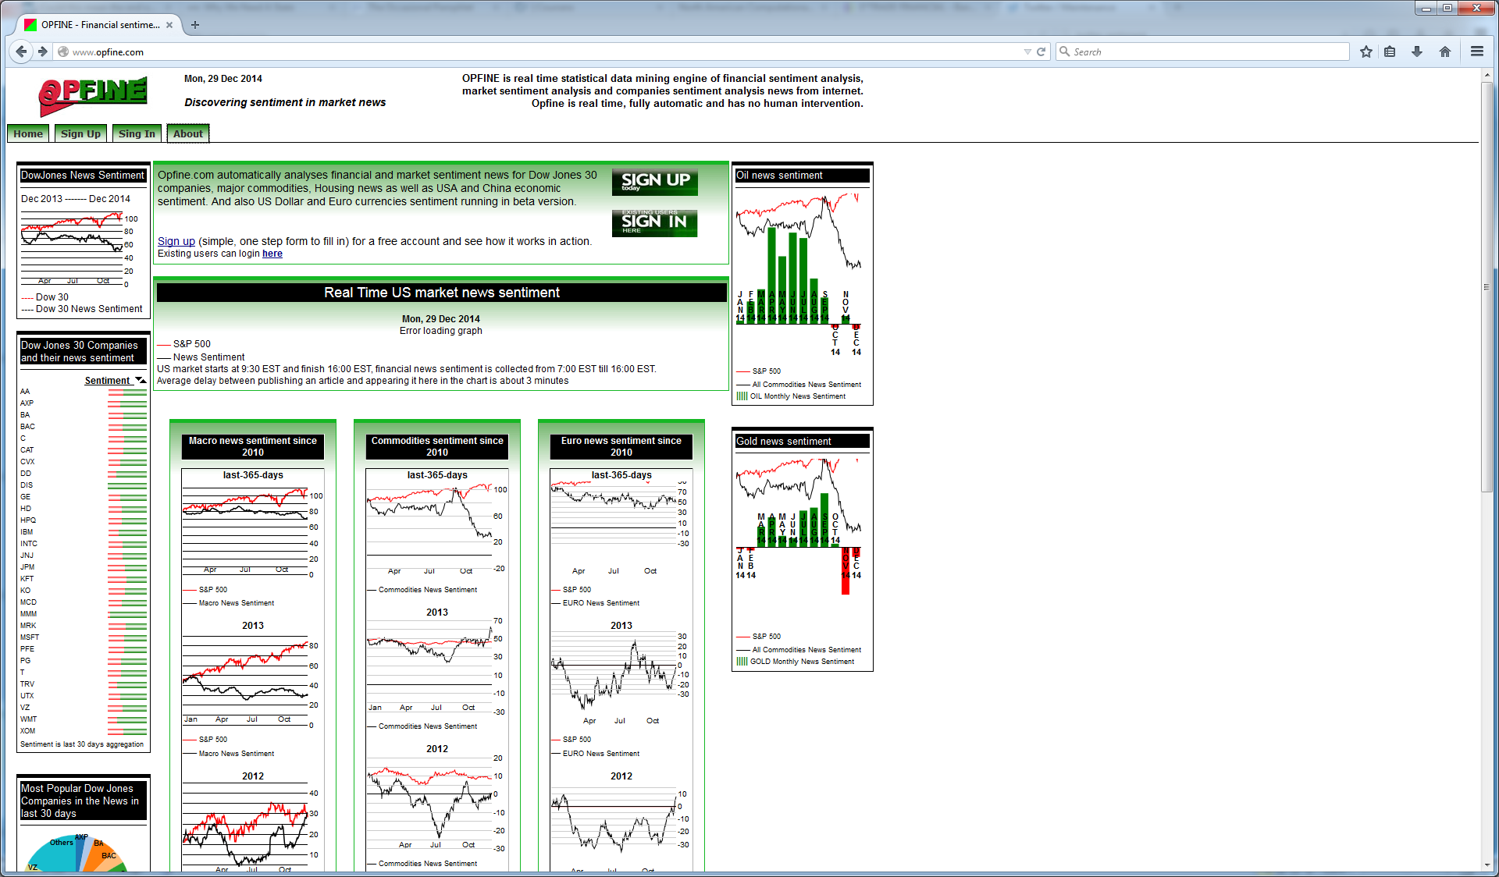
Sentiment about Companies

Slide 6
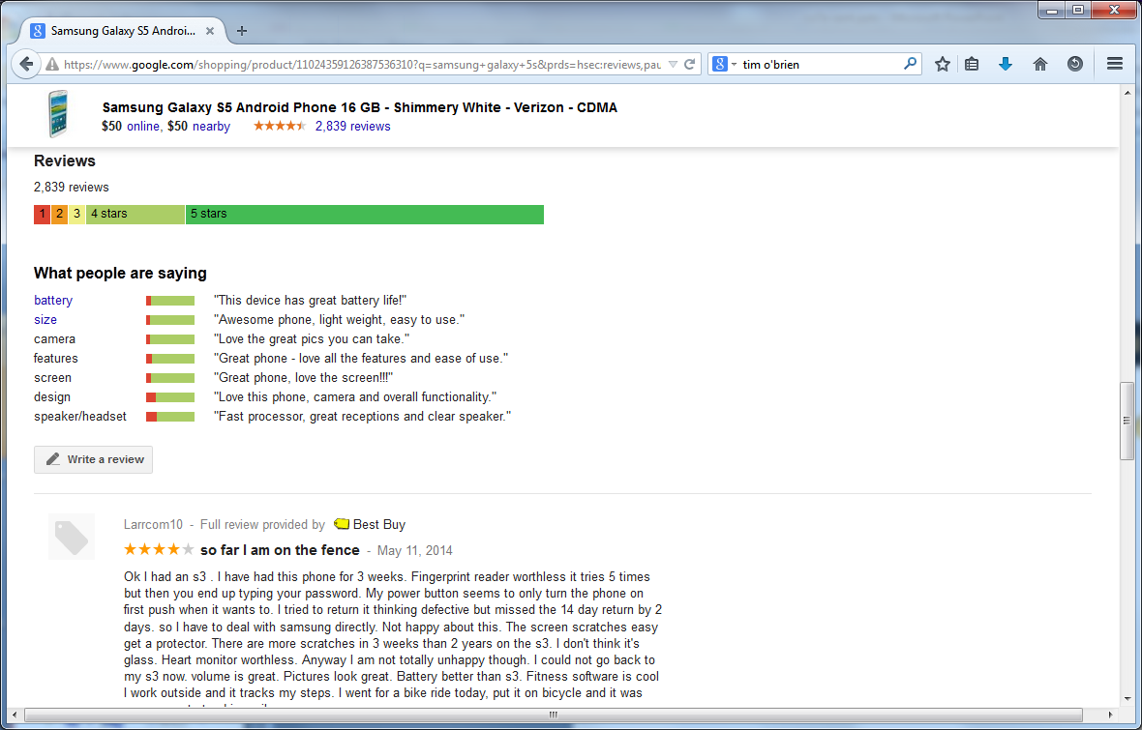
Product Reviews

Slide 7
Introduction
Many posts, blogs
Expressing personal opinions
Research questions
Subjectivity analysis
Polarity analysis (positive/negative, number of stars)
Viewpoint analysis (Chelsea vs. Manchester United, republican vs. democrat)
Sentiment target
entity
aspect

Slide 8
Introduction
Level of granularity
Document
Sentence
Attribute
Opinion words
Base
Comparative (better, slower)
Negation analysis
Just counting negative words is not enough

Slide 9
Reviews of 1Q84 by Haruki Murakami
“1Q84 is a tremendous feat and a triumph . . . A must-read for anyone who wants to come to terms with contemporary Japanese culture.” —Lindsay Howell, Baltimore Examiner
“Perhaps one of the most important works of science fiction of the year . . . 1Q84 does not disappoint . . . [It] envelops the reader in a shifting world of strange cults and peculiar characters that is surreal and entrancing.” —Matt Staggs, Suvudu.com
Ambitious, sprawling and thoroughly stunning . . . Orwellian dystopia, sci-fi, the modern world (terrorism, drugs, apathy, pop novels)—all blend in this dreamlike, strange and wholly unforgettable epic.” —Kirkus Reviews (starred review)

Slide 10
Reviews of 1Q84 by Haruki Murakami
“1Q84 is a tremendous feat and a triumph . . . A must-read for anyone who wants to come to terms with contemporary Japanese culture.” —Lindsay Howell, Baltimore Examiner
“Perhaps one of the most important works of science fiction of the year . . . 1Q84 does not disappoint . . . [It] envelops the reader in a shifting world of strange cults and peculiar characters that is surreal and entrancing.” —Matt Staggs, Suvudu.com
Ambitious, sprawling and thoroughly stunning . . . Orwellian dystopia, sci-fi, the modern world (terrorism, drugs, apathy, pop novels)—all blend in this dreamlike, strange and wholly unforgettable epic.” —Kirkus Reviews (starred review)

Slide 11
Notes
“raise” – can be negative or positive depending on the object
“very” – enhances the polarity of the adjective or adverb
http://www.theysay.io/ - claim to have 65,000 manual patterns

Slide 12
SA as a Classification Problem
Set of features
Words
Presence is more important than frequency
Punctuation
Phrases
Syntax
A lot of training data is available
E.g., movie review sentences and stars
Techniques
MaxEnt
SVM
Naive Bayes
RNN

Slide 13
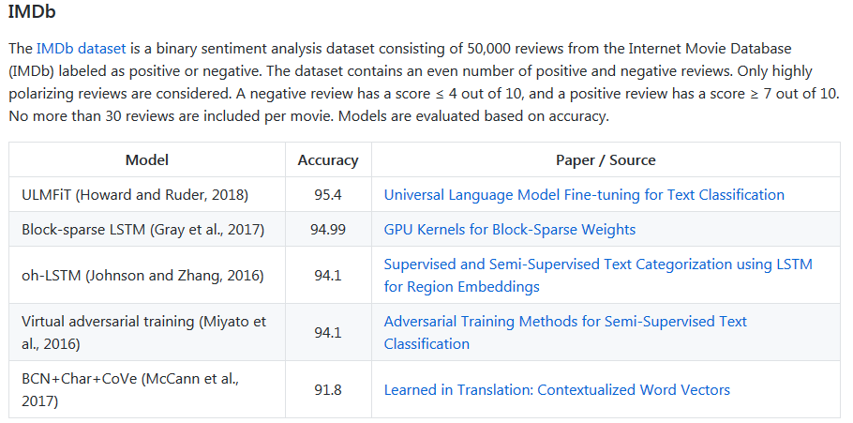
Results
https://github.com/sebastianruder/NLP-progress/blob/master/english/sentiment_analysis.md

Slide 14
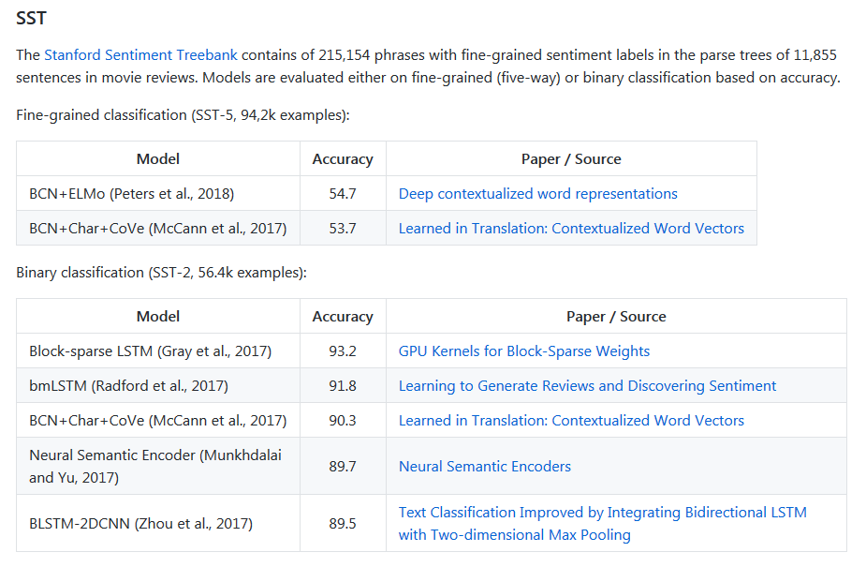
Results

Slide 15
Difficult Problems
Subtlety
Concession
Manipulation
Sarcasm and irony

Slide 16
Resources
CMU Twitter parser
http://www.ark.cs.cmu.edu/TweetNLP/

Slide 17
NLP

